Slide 1

^{Data Science:Diabetes}
ABSTRACT
Table of Contents
Introduction
Existing Method
Proposed method with Architecture
Methodology
Implementation
Conclusion

Slide 2
DESCRIPTION
Diabetes is a type of chronic disease which is more common among the people of all age groups.
Predicting this disease at an early stage can help a person to take the necessary precautions and change his/her lifestyle.
Accordingly to either prevent the occurrence of this disease or control the disease(For people who already have the disease).

Slide 3
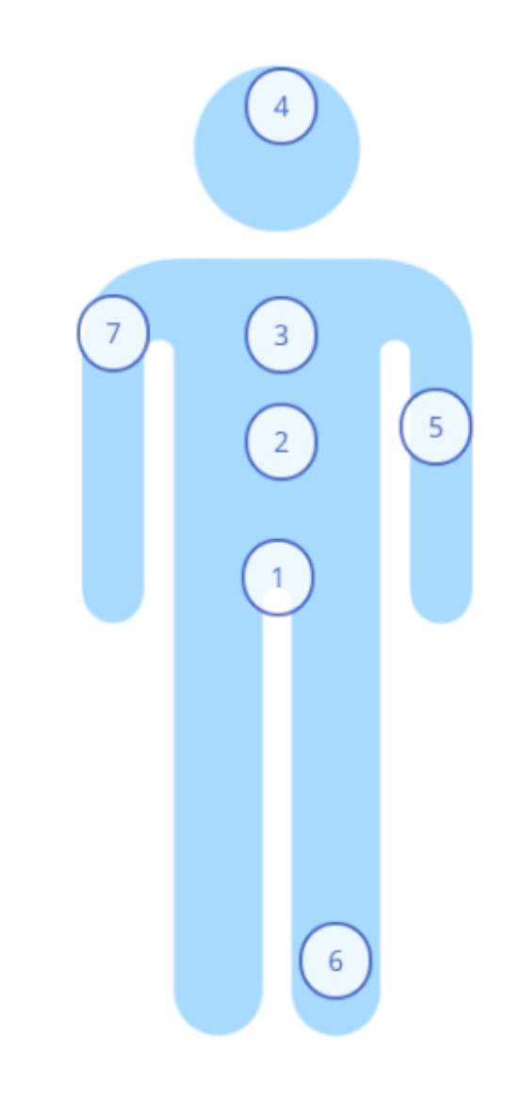
Ø Common Symptoms Of Diabetes Include:
1. Frequent Urination
2. Feeling very hungry or thirsty
3. Extreme Fatigue
4. Blurry Vision
5. Bruises or wounds that are slow to heal
6. Tingling, pain or numbness in feet or hands
7. Dry itchy skin

Slide 4
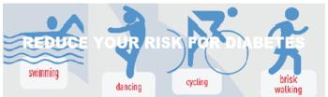
Reduce your risk for Diabetes by
30 minutes of Exercise can reduce risk for diabetes by 40%.
1. Swimming
2. Dancing
3. Cycling
4. Brisk walking

Slide 5
Prolonged hyperglycemia leads to a complex disorder called diabetes .
Mellitus which is associated with loss of glucose through urine and formation of harmful compounds known as ketene bodies.
Diabetic patients are successfully treated with insulin therapy.
An impairment affecting synthesis or release of ADH results in a diminished ability of the kidney to conserve water leading to water loss and dehydration.
This condition is known as Diabetes Insides’.

Slide 6
Uptake and Utilization.
As a result, there is a rapid movement of glucose from blood to hepatocytes and adiposities resulting in decreased blood glucose levels (hypoglycemia).
Insulin also stimulates conversion of glucose to glycogen (glycogen sis) in the target cells.
The glucose homeostasis in blood is thus maintained jointly by the two-insulin and glucagons.
Prolonged hyperglycemia leads to a complex disorder called diabetes.
Symptoms of Diabetes Mellitus = high blood sugar level , glycosuria , polyuria , nocturia , ketosis, polydipsia , polyphagia , weakness etc.
Diabetes insipid us can be cured by administration for ADH .( Anti- diuretic hormone )

Slide 7
Ex:
If a person happens to take large amount of water the amount of ADH in the blood will decreases.
ADH or Vasopressin is hormone secreted by pituitary that promotes reabsorptions of water from glomerular filtration.
but one can predict through its urine test can it be predicted through blood test

